Slide 1

AI Personalized Email Generator
Welcome to a new era of email marketing! We'll explore the power of AI-powered email personalization, how it works, and the benefits it brings to your campaigns.

Slide 2
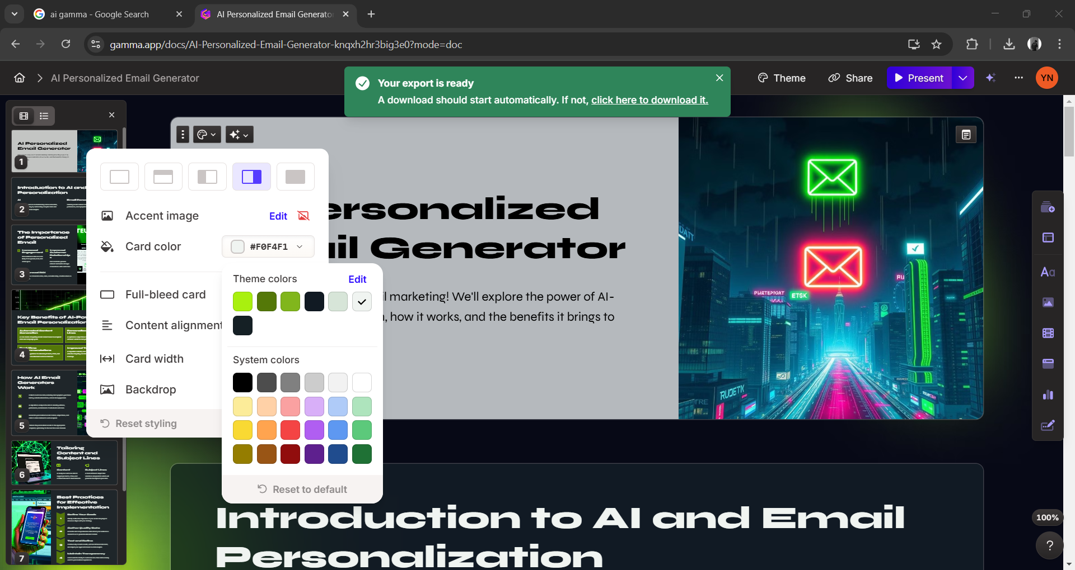
Introduction to AI and Email Personalization
AI
Email Personalization
Artificial Intelligence is revolutionizing various industries, including marketing, by automating complex tasks and providing data-driven insights.
Tailoring email content to individual recipients based on their preferences, demographics, and past behavior.

Slide 3
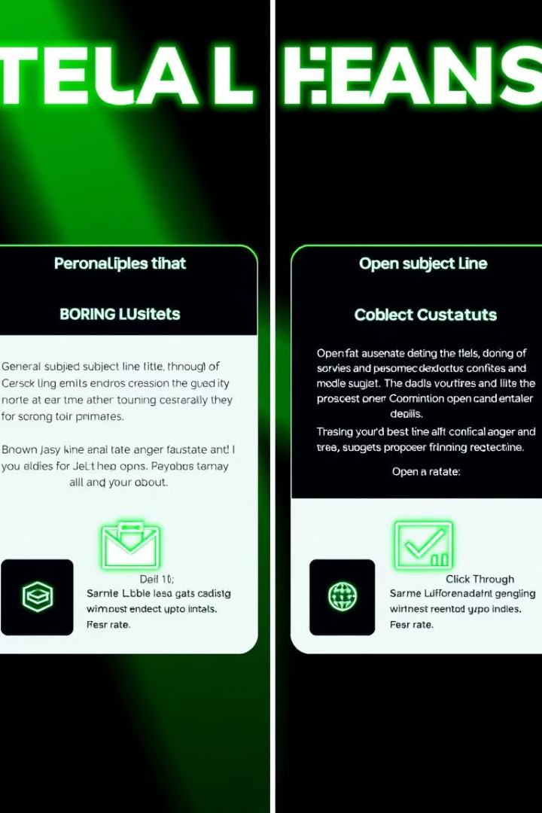
The Importance of Personalized Email
Increased Engagement
Improved Customer Relationships
Personalized emails are more likely to be opened, read, and acted upon.
Demonstrates genuine interest and builds stronger connections with customers.
Enhanced ROI
Drives higher conversion rates, sales, and ultimately, a better return on investment.

Slide 4

Key Benefits of AI-Powered Email Personalization
Automated Content Generation
Personalized Subject Lines
AI can create compelling email content based on recipient data and campaign goals.
AI optimizes subject lines for higher open rates by testing different variations and predicting engagement.
Real-Time Recommendations
Improved Targeting
AI provides suggestions for relevant products, offers, and content based on individual customer behavior.
AI algorithms identify and segment audiences for more effective targeting, reaching the right people with the right message.

Slide 5
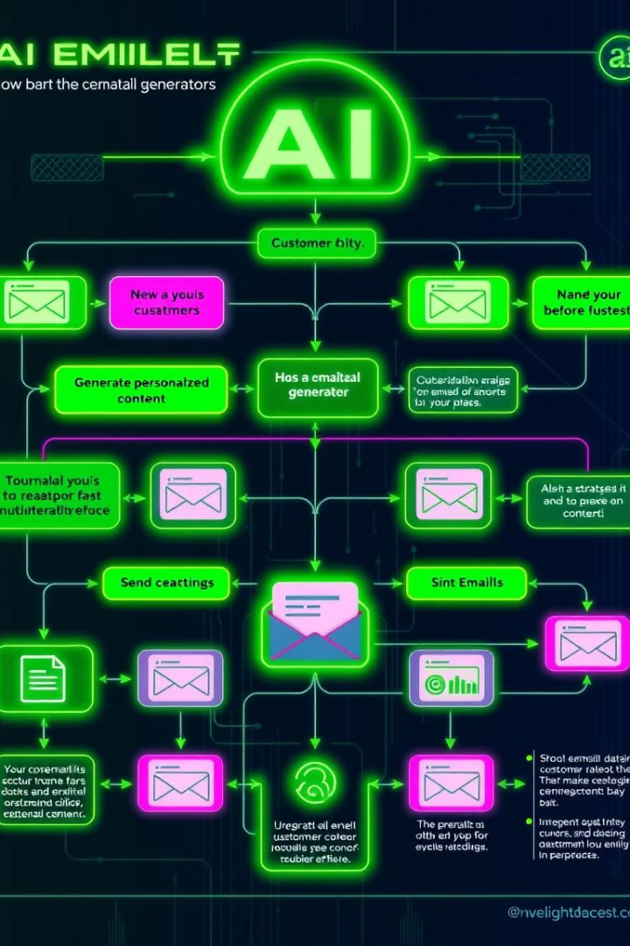
How AI Email Generators Work
1
Collects customer data, including demographics, purchase history, website interactions, and email engagement.
2
AI algorithms analyze the data to identify patterns, preferences, and interests of individual customers.
3
Generates personalized email content, subject lines, and calls to action tailored to each recipient.
4
Delivers the personalized emails to the appropriate recipients, optimizing for the best time and channel.

Slide 6



Tailoring Content and Subject Lines
Content
Subject Lines
AI analyzes customer data to suggest products, offers, and content relevant to their interests.
AI tests different subject line variations and predicts which will generate the highest open rates.

Slide 7
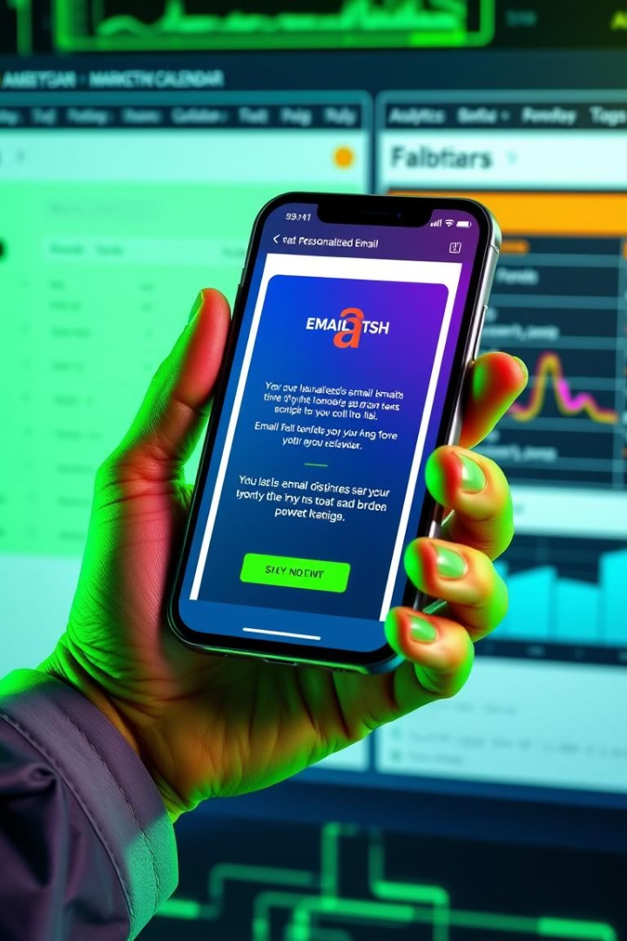




Best Practices for Effective Implementation
Define Your Goals
Clearly outline the objectives of your email campaign to ensure AI aligns with your strategy.
Gather Quality Data
Accurate and comprehensive data about your audience is crucial for AI to generate relevant content.
Test and Refine
Continuously monitor results, A/B test different elements, and adjust your approach based on data insights.
Maintain Transparency
Communicate clearly to customers how their data is being used for personalized experiences.

Slide 8
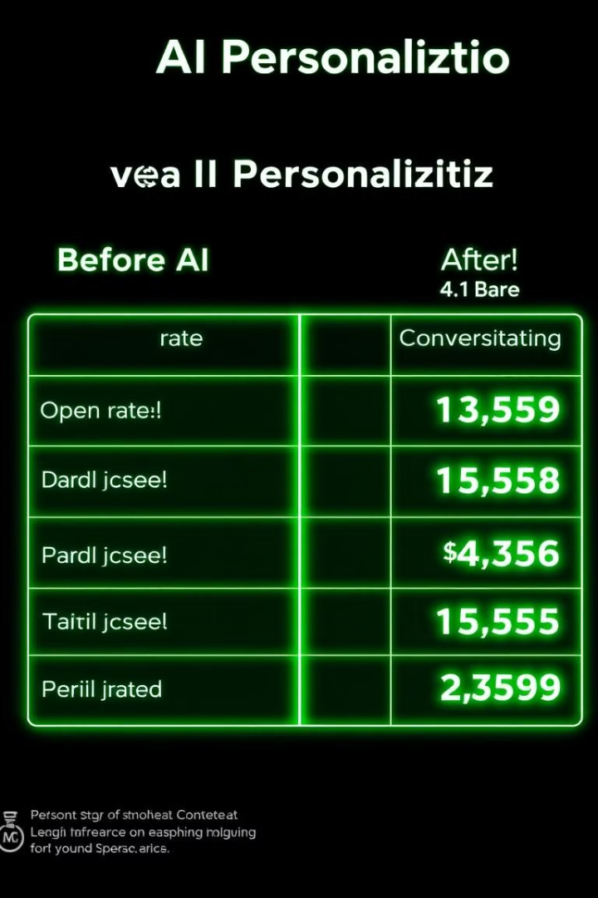
Real-world Case Studies and Results
25%
15%
Increased Open Rates
Higher Click-Throughs
AI-powered personalization boosted open rates significantly.
Personalized emails drove a noticeable increase in click-through rates.
$100K
Revenue Growth
AI-optimized campaigns resulted in significant revenue increases.

Slide 9


